Slide 1
Quadcopter Demo
Thomas Collins
Charlie Nitschelm
Lucas Simmonds
Ross Thyne

Slide 2
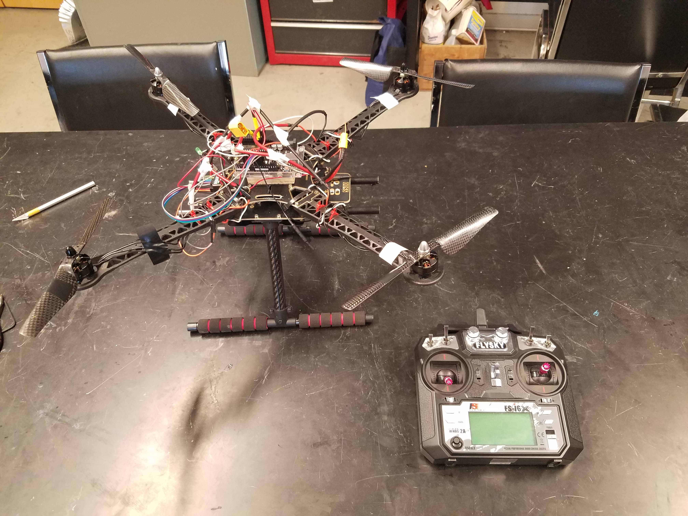

Slide 3
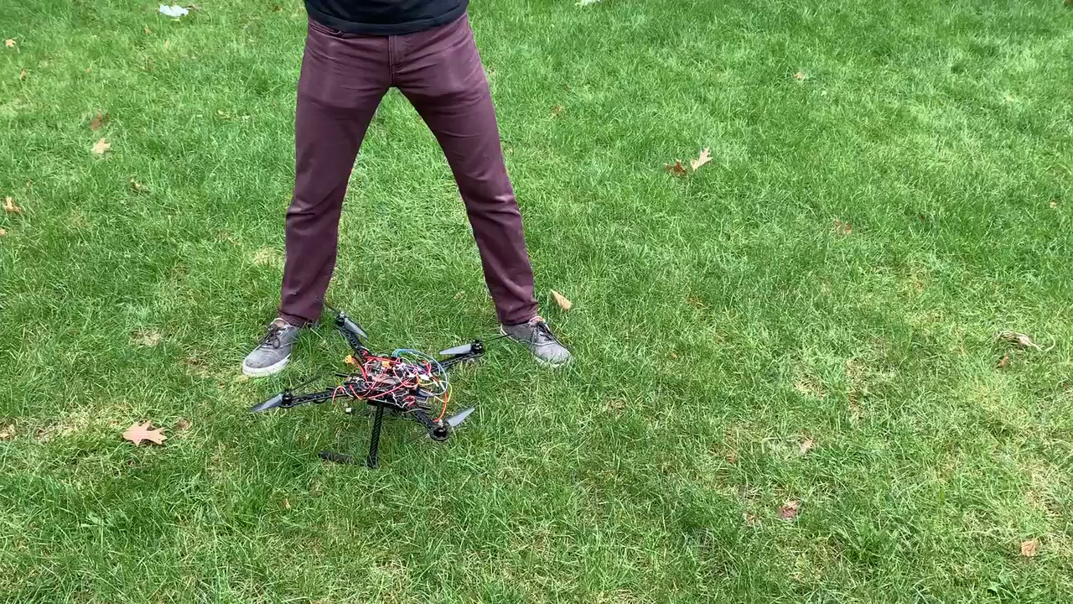
First Attempt

Slide 4
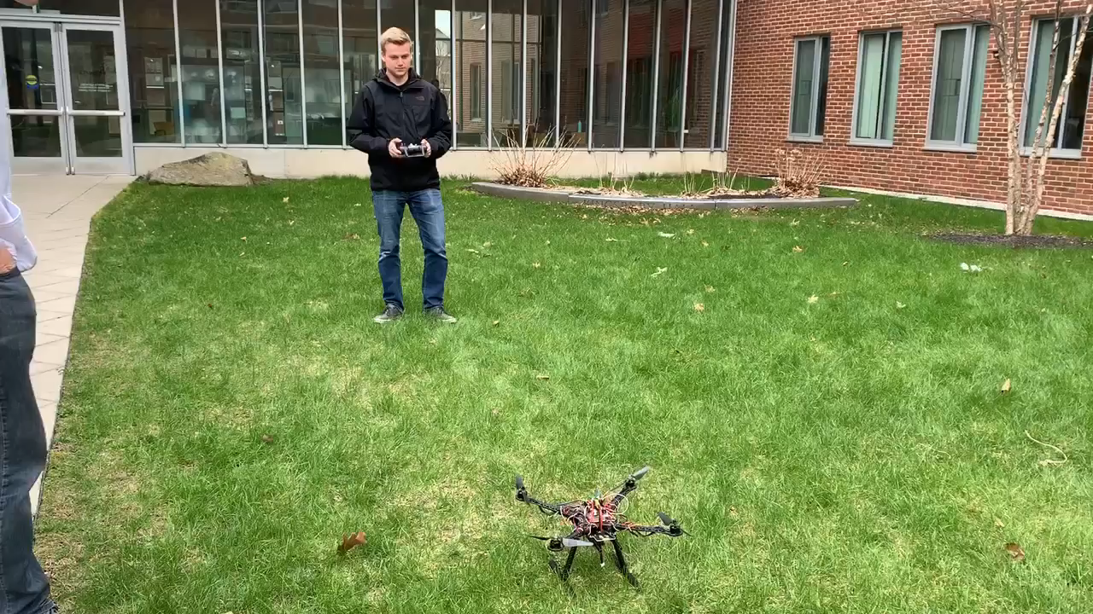
Improvements tbd.

